Slide 1


Akshatha G 4VM23CS001 Mahesh S 4VM23CS033
S Mohammed Maaz 4VM23CS043
Syeda Umme Haani 4VM23CS055
Vidya Vikas Institute of Engineering & Technology, Mysuru
Department of Computer Science and Engineering
Project on
AI POWERED AUTONOMOUS COCONUT HARVESTING SYSTEM
PRESENTED BY
Under the guidance of
Dr. Madhu B K
Dean Of CSE
VVIET
2025-2026

Slide 2
Vidya Vikas Institute of Engineering and Technology, Mysuru
Department of Computer Science and Engineering
CONTENTS
Introduction
Review of Literature
Problem Statement
Objectives
Methodology
Software and Hardware Requirements
Advantages
Expected Outcome
References
2025-2026

Slide 3
Vidya Vikas Institute of Engineering and Technology, Mysuru
Department of Computer Science and Engineering
INTRODUCTION
India harvests nearly five billion coconuts annually, but coconut farming still depends heavily on manual tree climbing, which is risky, labour-intensive, and increasingly affected by skilled worker shortages.
Our AI-Powered Coconut Harvesting System combines drone imaging, AI-based tree and coconut detection, a tree-climbing harvesting robot, and a real-time web dashboard to automate safe and targeted harvesting. The system detects trees, classifies coconuts by ripeness, creates automated harvest tasks, and enables the robot to harvest only the required coconuts, improving safety, reducing labour dependency, and increasing efficiency in smart agriculture.
2025-2026

Slide 4
Vidya Vikas Institute of Engineering and Technology, Mysuru
Department of Computer Science and Engineering
LITERATURE SURVEY
SL. NO | Author Name, Year of Publication | Title of the Paper, Journal of Publication | Methodology/Technique Implemented | Outcome (Advantages/Limitations)
1 | Dr. SaravanaKumar R, Akshay Prasad Dubey, Santosh Mohan (2016) | Autonomous Control and Implementation of Coconut Tree Climbing and Harvesting Robot- Procedia Computer Science (Elsevier) | Developed a climbing robot with DC motors and robotic cutting arm. | Reduced manual climbing effort but required manual supervision.
2 | M. Kumar, G. Bej, H. S. Pandey (2023) | Status and Scope of Automated Coconut Harvester in India: A Review - International Journal of Research in Engineering and Science (IJRES) | Reviewed automated harvesters using AI and vision techniques. | Highlighted limitations and future scope of smart harvesting systems.
3 | Hongcheng Zheng, Yuxing Fu, Zongbin Wang (2024) | Design and Experiment of Coconut Picking Robot with Climbing - International Journal of Agricultural and Biological Engineering | Designed a climbing robot with chain-saw cutter and STM32 controller. | Faster harvesting but lacked autonomous AI vision support.
4 | Samfford S. Cabaluna, Maria Fe P. Bahinting, Leah A. Alindayo (2024) | Computer-Vision-Based Detection and Monitoring System for Mature Coconut Fruits with a Web Dashboard Visualization Platform - International Journal of Advanced Computer Science and Applications(IJACSA) | Used YOLOv8 and computer vision for coconut maturity detection. | High detection accuracy but tested only in laboratory conditions.
2025-2026

Slide 5
Vidya Vikas Institute of Engineering and Technology, Mysuru
Department of Computer Science and Engineering
LITERATURE SURVEY
SL. NO | Author Name, Year of Publication | Title of the Paper, Journal of Publication | Methodology/Technique Implemented | Outcome (Advantages/Limitations)
5 | Mani A, Jothilingam A (2014) | Design and Fabrication of Coconut Harvesting Robot: COCOBOT - International Journal of Innovative Research in Science, Engineering and Technology (IJIRSET) | Developed a semi-autonomous robot with robotic arm and RF control. | Improved safety but lacked full automation.
6 | V. Ramesh, Deepak Kumar (2025) | AI and Sensor Based Smart Coconut Harvesting Machine - International Journal for Research in Applied Science and Engineering Technology (IJRASET) | Used AI algorithms and ultrasonic sensors for harvesting. | Reduced labor and improved harvesting efficiency.
7 | R. Karthikeyan, S. Praveen (2023) | AI Based Coconut Tree Climbing and Harvesting Robot - International Journal of Innovative Research in Engineering and Technology (IJIRET) | Implemented AI-enabled climbing and cutting mechanisms. | Reduced human risk and increased harvesting speed.
8 | Mohammed Afsal, N. Vivek (2024) | Smart Coconut Harvesting System using IoT and Machine Learning - International Journal of Scientific Research in Computer Science Engineering and Information Technology (IJSRCSEIT) | Applied IoT sensors and machine learning for coconut detection. | Enabled smart monitoring and accurate harvesting.
2025-2026

Slide 6
Vidya Vikas Institute of Engineering and Technology, Mysuru
Department of Computer Science and Engineering
LITERATURE SURVEY
SL. NO | Author Name, Year of Publication | Title of the Paper, Journal of Publication | Methodology/Technique Implemented | Outcome (Advantages/Limitations)
9 | Priya Sharma, Arun Raj (2025) | Deep Learning Based Coconut Detection for Automated Harvesting - Journal of Artificial Intelligence and Smart Agriculture | Used deep learning and CNN models for coconut detection. | Improved accuracy and reduced crop damage.
10 | A. Lakshmi, P. Harish (2024) | Autonomous Agricultural Harvesting Robot using Computer Vision - International Journal of Advanced Agricultural Technologies | Implemented autonomous navigation and object detection. | Increased productivity but affected by poor lighting conditions.
11 | K. Suresh, M. Dinesh (2022) | Robotic Arm for Coconut Harvesting in Agricultural Fields - International Conference on Smart Farming Technologies | Developed robotic arm with wireless harvesting control. | Safer harvesting compared to manual climbing.
12 | Arun Kumar, S. Naveen (2023) | Machine Learning Based Smart Agriculture Harvesting System - International Journal of Machine Learning and Computing | Used machine learning models and smart sensors for crop harvesting. | Improved automation and reduced harvesting time.
2025-2026

Slide 7
Vidya Vikas Institute of Engineering and Technology, Mysuru
Department of Computer Science and Engineering
Problem Statement
Coconut harvesting in India still depends on manual tree climbing, which is risky, labour-intensive, and costly due to the shortage of skilled workers. Farmers also face difficulties in identifying mature coconuts and managing harvesting efficiently on large plantations, leading to reduced productivity and crop loss.
2025-2026

Slide 8
Vidya Vikas Institute of Engineering and Technology, Mysuru
Department of Computer Science and Engineering
Objectives
To automate the detection, GPS tagging, and location mapping of coconut trees using drone-captured aerial imagery and AI-based vision models.
To classify coconuts by ripeness and generate farmer-controlled harvest task queues stored in a structured database.
To enable a tree-climbing robot to autonomously execute harvesting tasks by communicating with a backend API in real time.
To develop a web-based dashboard that provides farmers with live monitoring of plantation status, tree health, and harvest progress.
2025-2026

Slide 9
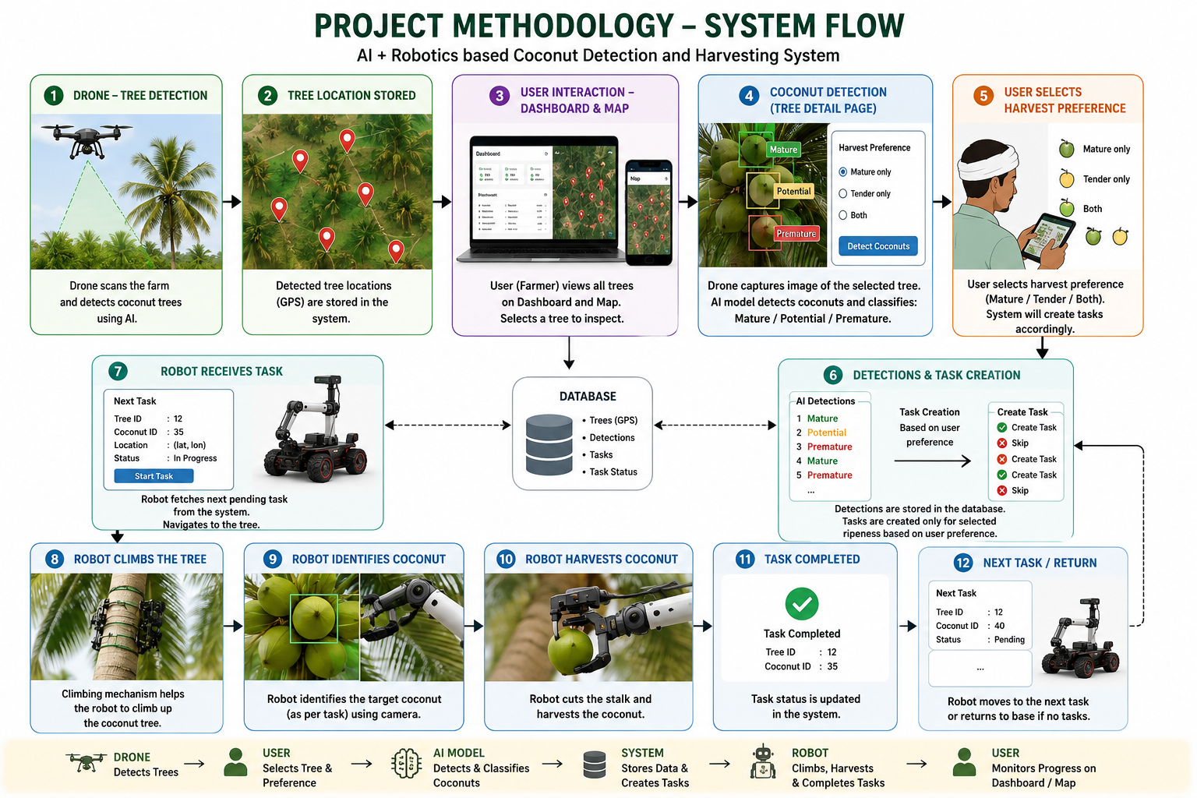
Vidya Vikas Institute of Engineering and Technology, Mysuru
Department of Computer Science and Engineering
Methodology
2025-2026

Slide 10
Vidya Vikas Institute of Engineering and Technology, Mysuru
Department of Computer Science and Engineering
Software and Hardware Requirements
Software Requirements
Backend – Python, FastAPI, Uvicorn, PostgreSQL, python-dotenv for configuration management.
AI / Vision – YOLOv8 (Ultralytics), OpenCV, Pillow for image processing and model inference.
Frontend – Next.js 16, React 19, TypeScript, Tailwind CSS, React-Leaflet for interactive farm map visualization.
Simulation & Visualization – A robot simulation framework like Gazebo or Webots to visually simulate the tree-climbing robot and harvesting process before real-world deployment.
Other – Git for version control, Postman for API testing, VS Code as the primary IDE.
Hardware Requirements
Drone – GPS-enabled drone with a downward-facing camera for aerial plantation scanning.
Onboard Camera / Edge Device – Camera module attached to the robot for close-up coconut ripeness detection.
Tree-Climbing Robot – Motorised robotic unit capable of climbing coconut trees and cutting/plucking coconuts on command.
Processing Unit – A laptop or server (minimum 8GB RAM, preferably with GPU) to run the FastAPI backend and YOLO inference.
2025-2026

Slide 11
Vidya Vikas Institute of Engineering and Technology, Mysuru
Department of Computer Science and Engineering
Advantages
Zero Manual Climbing - Eliminates the need for workers to climb tall trees, significantly reducing the risk of fatal accidents and injuries.
AI-Driven Precision - YOLOv8 models detect and classify coconuts by ripeness, ensuring only the right coconuts are harvested at the right time, reducing yield waste.
Scalable & Automated - The task queue system allows one robot to work continuously across an entire plantation without human intervention, handling hundreds of trees efficiently.
Real-Time Farm Intelligence - The live dashboard and GPS map give farmers instant visibility into every tree's status, coconut count, and harvest progress from any device.
Farmer-Controlled Preferences - Farmers can choose to harvest mature coconuts, tender coconuts, or both giving full control over what gets harvested without changing the system.
2025-2026

Slide 12
Vidya Vikas Institute of Engineering and Technology, Mysuru
Department of Computer Science and Engineering
Expected Outcome
An automated drone scanning system capable of detecting and GPS-tagging coconut trees across any plantation without manual input.
A trained YOLOv8 model that accurately classifies coconuts as mature or tender from camera images with consistent confidence.
A smart task management system that generates and prioritises harvest tasks based on farmer preference and real-time detection data.
A tree-climbing robot that operates independently by reading tasks from the API and reporting task completion back to the system.
A responsive web dashboard with an interactive map, giving farmers complete visibility over every tree and harvest task on their farm.
2025-2026

Slide 13
Vidya Vikas Institute of Engineering and Technology, Mysuru
Department of Computer Science and Engineering
References
Wibowo, S. et al. (2016). Autonomous Coconut Harvesting Robot. — End-to-end robotic system with climbing and fastening mechanism for coconut plantations. https://www.scribd.com/document/910220402/wibowo2016
Rathod, A. et al. (2016). Autonomous Control and Implementation of Coconut Tree Climbing and Harvesting Robot. Procedia Computer Science, Elsevier.sciencedirect
Amrita University (2015). Prototype of a Coconut Harvesting Robot with Visual Feedback. Advances in Intelligent Systems and Computing, Springer India.amrita
IOSR Journal of Engineering (2025). Coconut Harvest Mechanization Robot (CHMR) — Autonomous Device for Optimizing Coconut Harvesting. Vol. 15, Issue 1.iosrjen
Journal of Engineering and Applied Innovation (2023). Status and Scope of Automated Coconut Harvester in India. JEAI.journaljeai
JOUAV (2023). Agriculture Drones — Farming Drone for Crop Monitoring and Precision Farming. jouav.com, October 2023.jouav
2025-2026

Slide 14
Vidya Vikas Institute of Engineering and Technology, Mysuru
Department of Computer Science and Engineering
References
International Journal of Advanced Computer Science and Applications (2023). Detection of Fruit using YOLOv8-based Single Stage Object Detection for Precision Agriculture. IJACSA, Vol. 14, Issue 12.thesai
Nature Scientific Reports (2024). YOLOv8-CML: A Lightweight Target Detection Method for Intelligent Agriculture. Nature, 2024.nature
Frontiers in Plant Science (2025). RLK-YOLOv8: Multi-Stage Detection of Fruits Using Improved YOLOv8. Frontiers, Vol. 16.frontiersin
CGIAR (2025). From Sky to Soil: How Drones are Revolutionizing Crop Monitoring. CGIAR Research, March 2025.cigar
Journal of Agricultural and Crop Research (2025). Optimizing Crop Monitoring Efficiency and Precision with Drone Technology. ACRI, 2025.journalacri
Equinox Drones (2024). Agriculture Drones for Precision Farming — UAV Aerial Imagery with Machine Learning. equinoxsdrones.com, 2024.equinoxsdrones
2025-2026

